Slide 1
What? How? Why? Who?

Slide 2
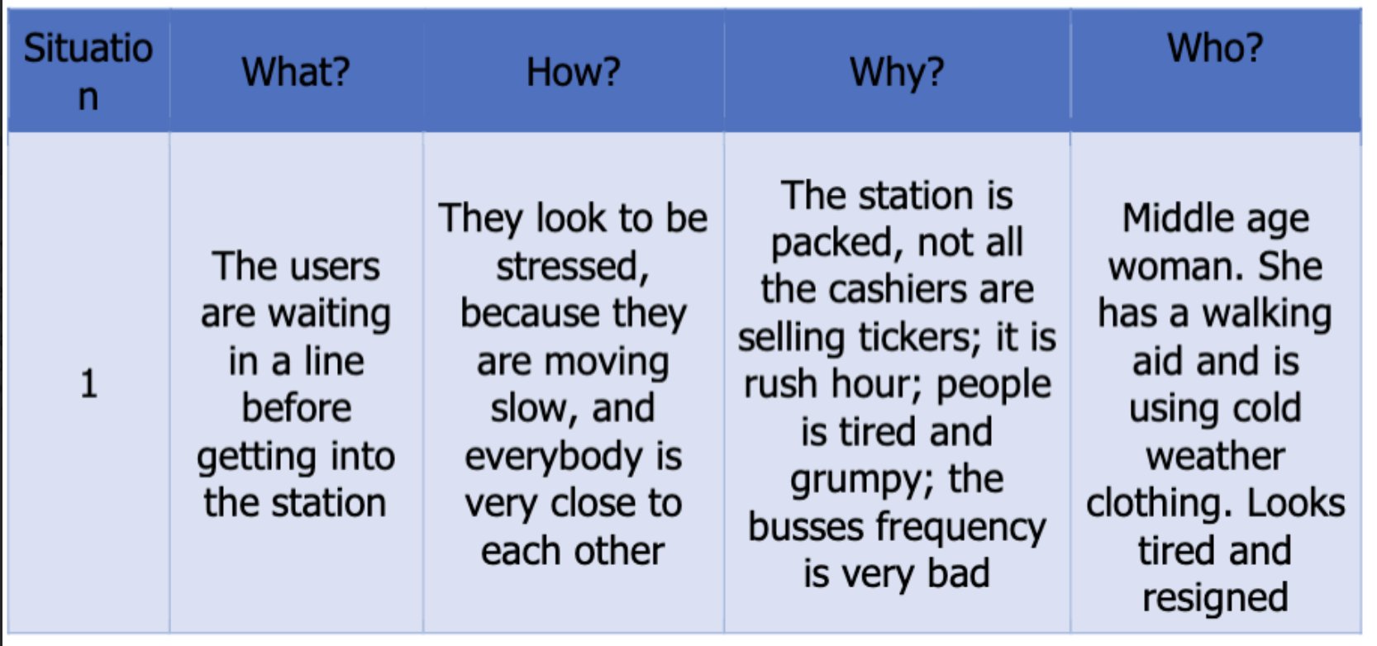

Slide 3
Interview 1: Daniella
N | What | How | Why | Who
1
2
3
4

Slide 4
Interview 2: Lucas
N | What | How | Why | Who
1
2
3
4

Slide 5
Interview 3: Hannah
N | What | How | Why | Who
1 | Seeking a store that offer a specific product with reasonable prices and in a safe location by walking nearby. | Walking fast, clutching her phone, glancing back and making sure no one is following her, asking around before and during her search for the store. | She needs to get this product quickly and in a place nearby as she tries to adapt and combine her lifestyle abroad to the new reality in Colombia and all it entails | Hannah an exchange student from Germany who got to Bogotá in the last two months
2 | Not ordering online any products as she doesn’t know how to use the platform in a way that ensure she doesn’t get scammed | The online platforms in Colombia differ from the ones in their country, and it is mostly in spanish a language they are still working on learning | They aren’t sure how to choose which product without seeing them in person, and how to ask for a refund if it doesn’t work. Also they want to make the most of their time in Colombia and get to know the culture | Hannah an exchange student from Germany who got to Bogotá in the last two months
3 | A vegetarian is looking for a gastronomic offer of quality near the University | Following along her friends discoveries and walking around looking for a place that looks appetizing without too much wait time | She wants to find places to eat out and enjoy the local cousin within her vegetarian restrictions. | Hannah an exchange student from Germany who got to Bogotá in the last two months
4 | A foreign student is looking for places to eat out at that are nearby and with quality healthy food | By asking around to others, to learning from her own experience which places are or aren’t that safe | Eating is a key part of getting to know the culture and having a fun time, however different types of spices and cooking may make them sick | Hannah an exchange student from Germany who got to Bogotá in the last two months

Slide 6
Interview 4: Itzell
N | What | How | Why | Who
1 | The participant seems interested in trying the regional food available in her nearby or distant area. | She expresses her interest by making a comparison of the food she has tried and saying that the mobility is not a problem for her | She is new in the city and she’s excited to investigating new options for something new to eat | Itzell Arredondo, a Mexican student that’s new in the city
2 | The participant can relate food to his homeland but not 100% so she keeps looking for related options | She express that she found relatable food in colombia, but there’s a lot of ingredients that she misses from home that can be maybe found | She is from a country with a deep and diverse culinary taste as it's Mexico, those flavors are noticeable and there’s a lot of Mexican food restaurants in Colombia that can remind her of home. | Itzell Arredondo, a Mexican student that’s new in the city
3 | She had a trial error process figuring out cool places to eat, so she had to try in a lot of places and it’s still looking for more places to eat | She told us about her process of finding a nice place to eat, her criteria, she mostly used voice to voice or trial and error to find out a place that she can consistently go to. | She has no problem trying new foods, but she had to invest her time and to hear other people to get information that can be relative about places to eat around the campus. | Itzell Arredondo, a Mexican student that’s new in the city
4 | She was expecting more of our typical restaurants, the offering that was at her reach was not enough to give her the experience she wanted | She expressed her disappointment about the food of the typical restaurants in Bogotá, and that maybe the best way is to go directly to the regions to eat. | She had an idea that the Colombian gastronomy is more deep and it surely can offer better flavors or more quality, and she is willing to try them even if they are further of her location | Itzell Arredondo, a Mexican student that’s new in the city

Slide 8
Interview 6: Niels
N | What | How | Why | Who
1 | The participant struggles in navigating the university campus, finding specific locations, and understanding building names. | The participant describes issues with locating the sports center, restroom facilities, and classrooms on campus. | It seeks to understand the specific challenges Niels faced with campus navigation to identify areas for improvement | Niels a German/French student that is new to the city.
2 | The participant struggles finding the best way possible to his classes | The participant's challenges are connected to the complexity of the university campus layout, which may include numerous buildings, various paths, and unclear signage. | As a newcomer or exchange student, the participant may not be familiar with the campus layout and the most efficient routes to their classes. | Niels a German/French student that is new to the city.
3 | The participant has used navigational apps, but prefers to find by himself the location that he is looking. | The participant remarks that is easy to locate any direction in the city. | The participant doesn't like to share his exact position with big companies | Niels a German/French student that is new to the city.
4 | The participant thinks that it would be helpful a navigation app for the campus | The participant suggests the need for an interactive campus map, similar to Google Maps, to ease navigation for himself and other students. | Ultimately, it aims to gather information that could help improve the campus navigation experience for international students at the University of Los Andes in Bogotá. | Niels a German/French student that is new to the city.

